Slide 1

Lecture
on
“CBNST LAB –PMA-402”
by
Akansha Gupta
DEPARTMENT OF COMPUTER SCIENCE AND ENGINEERING
GRAPHIC ERA DEEMED TO BE UNIVERSITY

Slide 2
BISECTION METHOD

Slide 3
Bisection Method
Bisection method is used to find the real roots of a nonlinear equation. The process is based on the ‘Intermediate Value Theorem‘.
According to the theorem “If a function f(x)=0 is continuous in an interval (a,b), such that f(a) and f(b) are of opposite nature or opposite signs, then there exists at least one or an odd number of roots between a and b.”
For example: y= x³-x-1=f(x)
Bisection method is a closed bracket method and requires two initial guesses. It is the simplest method with slow but steady rate of convergence. It never fails!
The overall accuracy obtained is very good, so it is more reliable in comparison to the Regula-Falsi method or the Newton-Raphson method.
It is also known as Binary Search or Half Interval or Bolzano Method.

Slide 4
Features of Bisection Method
Type – closed bracket
No. of initial guesses – 2
Convergence – linear
Rate of convergence – slow but steady
Accuracy – good
Programming effort – easy
Approach – middle point

Slide 5
Assumptions
f(x) is a continuous function in interval [a, b]
f(a) * f(b) < 0
Steps:
Find middle point c= (a + b)/2 .
If f(c) == 0, then c is the root of the solution.
Else f(c) != 0
If value f(a)*f(c) < 0 then root lies between a and c. So we recur for a and c
Else If f(b)*f(c) < 0 then root lies between b and c. So we recur b and c.
Else given function doesn’t follow one of assumptions.

Slide 6
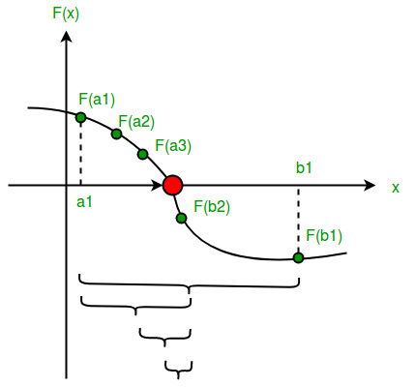
Since root may be a floating point number, we repeat above steps while difference between a and b is less than a value ? (A very small value).

Slide 7
Bisection Method Algorithm
1. Start
2. Define function f(x)
3. Choose initial guesses x0 and x1 such that f(x0)f(x1) < 0
4. Choose pre-specified tolerable error e.
5. Calculate new approximated root as x2 = (x0 + x1)/2
6. Calculate f(x0)f(x2)
a. if f(x0)f(x2) < 0 then x0 = x0 and x1 = x2
b. if f(x0)f(x2) > 0 then x0 = x2 and x1 = x1
c. if f(x0)f(x2) = 0 then goto (8)
7. if |f(x2)| > e then goto (5) otherwise goto (8)
8. Display x2 as root.
9. Stop

Slide 8
Pseudocode for Bisection Method
1.Start
2. Define function f(x)
3. Input
Lower and Upper guesses x0 and x1
tolerable error e
4. If f(x0)*f(x1) > 0
print "Incorrect initial guesses"
goto 3
End If
5. Do
x2 = (x0+x1)/2
If f(x0)*f(x2) < 0
x1 = x2
Else
x0 = x2
End If
while abs(f(x2) > e
6. Print root as x2
7. Stop

Slide 9
Advantages of Bisection Method
Convergence is guaranteed: Bisection method is bracketing method and it is always convergent.
Error can be controlled: In Bisection method, increasing number of iteration always yields more accurate root.
Does not involve complex calculations: Bisection method does not require any complex calculations. To perform Bisection method, all we need is to calculate average of two numbers.
Guaranteed error bound: In this method, there is a guaranteed error bound, and it decreases with each successive iteration. The error bound decreases by ½ with each iteration.
Bisection method is very simple and easy to program in computer.
Bisection method is fast in case of multiple roots.

Slide 10
Disadvantages of Bisection Method
Slow Rate of Convergence: Although convergence of Bisection method is guaranteed, it is generally slow.
Choosing one guess close to root has no advantage: Choosing one guess close to the root may result in requiring many iterations to converge.
Can not find root of some equations. For example: f(x) = x² as there are no bracketing values.
It has linear rate of convergence.
It fails to determine complex roots.
It can not be applied if there are discontinuities in the guess interval.
It can not be applied over an interval where the function takes values of the same sign.

Slide 11
Convergence of Bisection Method
The rate of convergence of the Bisection method is linear and slow but it is guaranteed to converge if function is real and continuous in an interval bounded by given two initial guess.
Accuracy of bisection method is very good and this method is more reliable than other open methods like Secant, Newton Raphson method etc.
Despite being slower to converge, accuracy of this method increases as number of iterations increases.

Slide 12
https://youtu.be/sLKP1bwaxg4
THANKS

